Slide 1
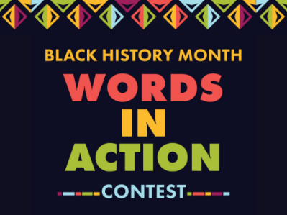
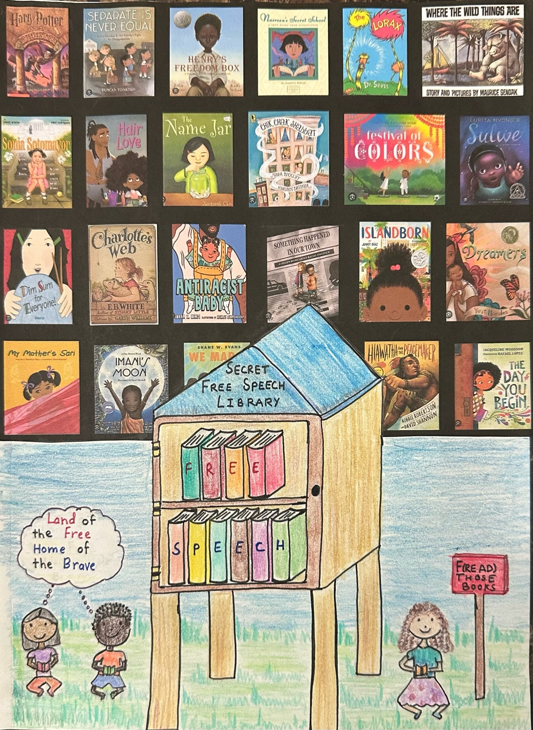
WINNER, K-8 Itisha Budamagunta Eagle Ridge Academy
Which Black American civil rights leader quote are you referencing for your submission?
“Where you see wrong or inequality or injustice, speak out, because this is your country.”
Thurgood Marshall
1978, UVA Commencement Address
Banning books tries to hide the struggles of African American people and may remove information that is an important part of their identifies and stories. This puts free speech in danger.

